Slide 1
Students,
Please utilize this as a starting point for your own case study, do not just use the same incident/slides.
Use true bullet-points to guide the brief/discussion -- the bulk of the information should be in your head not on the slide.
Ensure the slides can be pulled up on the computer before the scheduled briefing and consider printing the slides as a backup for technical malfunctions.
S/F
TiltMafia

Slide 2
MV-22B Aerial Refueling
13 December 2016
Okinawa, Japan

Slide 3
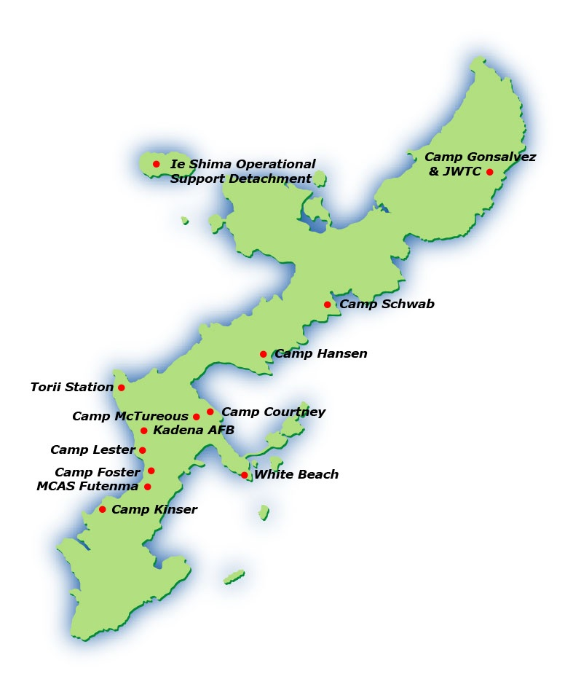
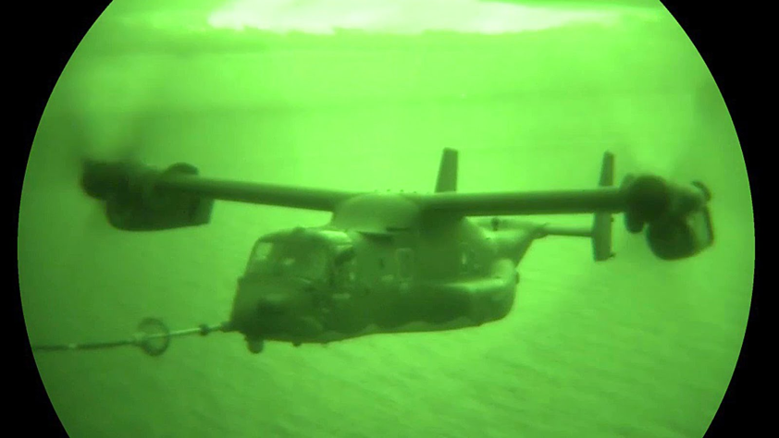
Scenario
USAF C-130
USMC MV-22B
5 Osprey Crewmembers
Night Ops -- 2200 Local
Video: Aerial Refueling

Slide 4
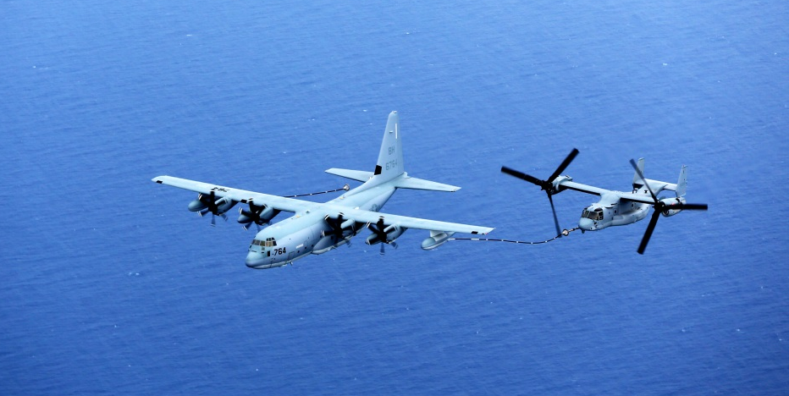
Mishap
Hose-Prop Collision
Vert/Hor Separation
Heavy Vibrations
SAR Coordination
Shallow Water Ditch

Slide 5
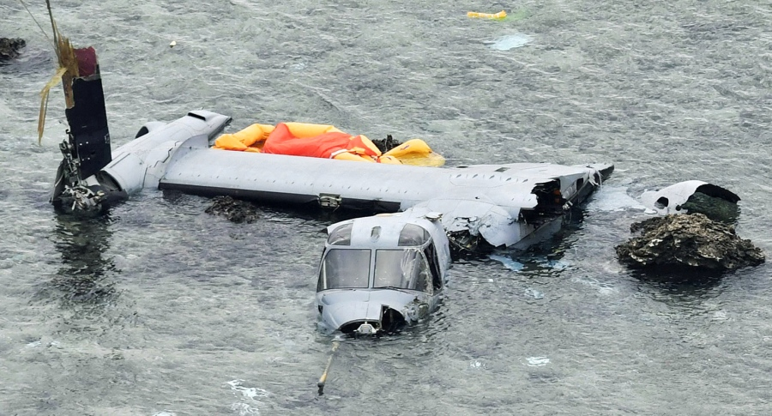
Outcome
Aircraft Destroyed
2/5 Crew Injured
5/5 Crew Survive
International Tensions
Flight Ops Suspended

Slide 6
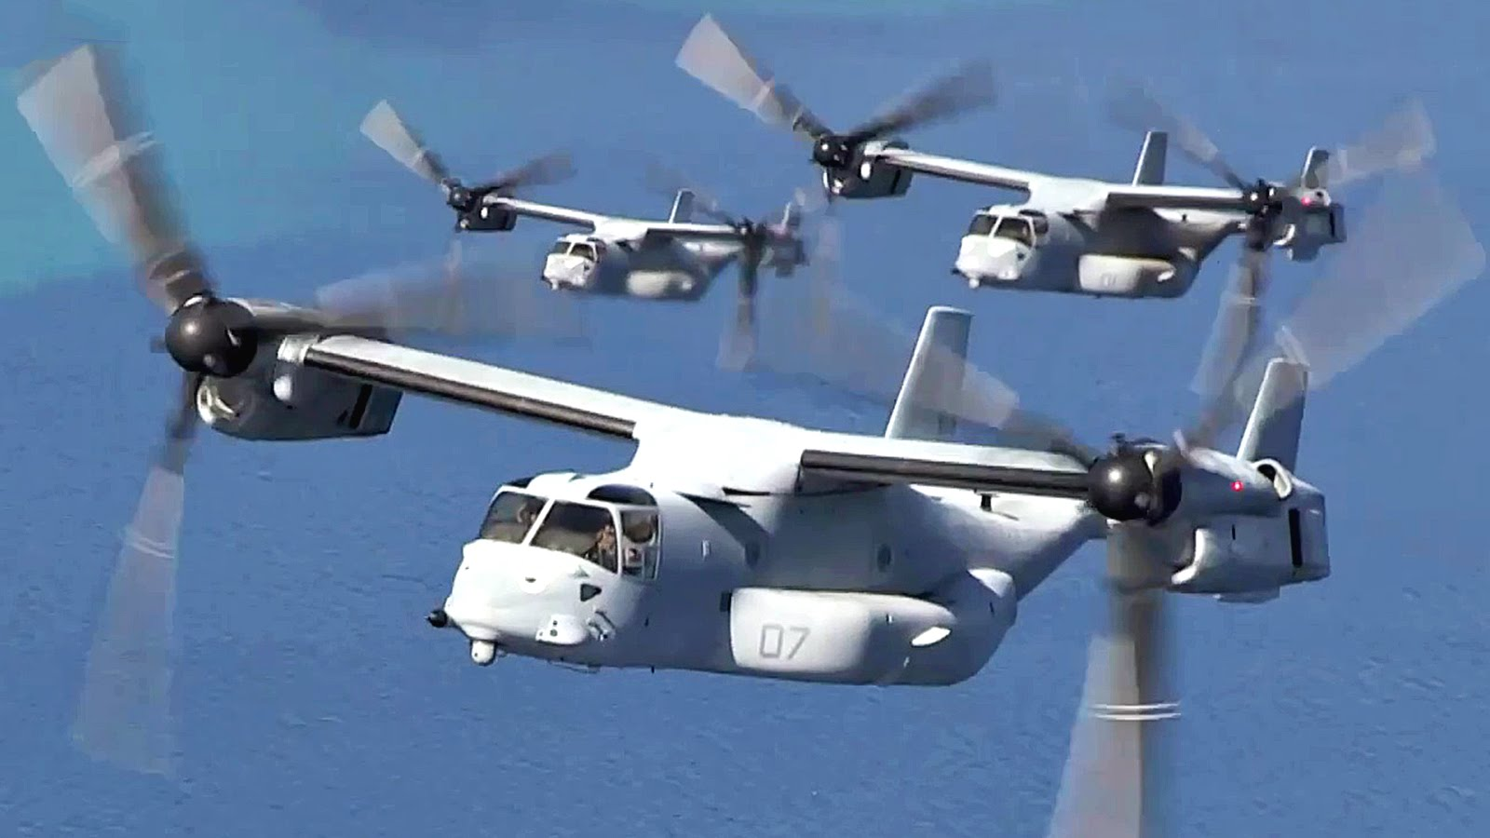
CRM
Decision Making
Ditch v Press
Civilian Lives
Assertiveness
Class A Mishap
Mission Analysis
Necessity
Location
Communication
Crew
SAR
Leadership
Selflessness
International Relations
Adaptability/Flexibility
Landing Sites
Situational Awareness
Geographical

